Slide 1

FinFlexx
Forecasting Financial Fortunes : A deep dive into the Stock Market Analysis and Prediction

Slide 2

Index
Introduction to Stock Market
Our Vision
Introduction to Stock Market Analysis
Data Collection and Preprocessing
Frontend Development of Website
Machine Learning Model for Stock Market Prediction
SWOT Analysis
Gallery
Conclusion

Slide 3

Introduction to Stock Market
The stock market is the collection of markets where stocks and other securities are bought and sold by investors.
Publicly traded companies offer shares of ownership to the public, and those shares can be bought and sold on the stock market.
Investors can make money by buying shares of a company at a low price and selling them at a higher price.

Slide 4

Our Vision
Our goal is to give our consumers a smooth Stock Market experience from Analyzing it to Predicting the future prices of the stock and beyond.
The aim of the project is to examine a number of different forecasting techniques to predict future stock returns based on past returns and numerical news indicators.

Slide 5


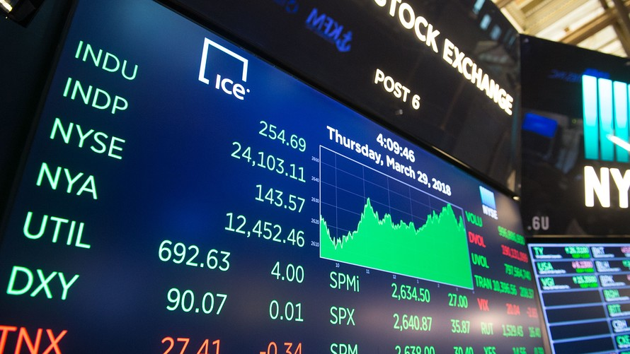
Introduction to Stock Market Analysis
Stock analysis refers to the method that an investor or trader uses to evaluate and investigate a particular trading instrument, investment sector, or the stock market as a whole.
Stock analysis helps traders to gain an insight into the economy, stock market, or securities.
Stock analysis is a process followed by traders to evaluate and understand the value of a security or the stock market.

Slide 6

Data Collection and Preprocessing
Data collection plays a crucial role in stock trading by providing traders and investors with the information needed to make informed decisions.
Stock trading relies heavily on data analysis to identify trends, assess risk, and execute trades effectively.
Data preprocessing in stock market analysis involves the cleaning, transformation, and preparation of raw market data before it is used for analysis or modeling purposes.

Slide 7

Frontend Development of Website
HTML : The Hyper Text Markup Language (HTML) is the standard markup language for documents designed to be displayed in a web browser.
CSS : Cascading Style Sheets (CSS) is a style sheet language used for describing the presentation of a Webpage.
JavaScript : JavaScript (JS) allows developers to create a dynamic and interactive web page to interact with visitors and execute complex actions.

Slide 8

Machine Learning Model for Stock Market Prediction
We have used Linear Regression Model for the Stock Price Prediction Process.
Linear Regression is a statistical model which estimates the linear relationship between a scalar response and one or more explanatory variables (also known as Dependent and Independent variables).
The case of one explanatory variable is called Simple Linear Regression; for more than one, the process is called Multiple Linear Regression.

Slide 9
SWOT Analysis
STRENGTHS
Simplicity
Computational Efficiency
Well-Studied
STRENGTHS
S
WEAKNESS
T
THREATS
Assumption of Linearity
Limited Flexibility
Multicollinearity
SWOT
OPPORTUNITIES
Model Enhancement
Integration with Other Methods
Application in Diverse Domains
W
O
WEAKNESS
THREATS
OPPORTUNITIES
Competition from more Advanced Models
Data Quality Issues
Rapid Technological Advancements

Slide 10

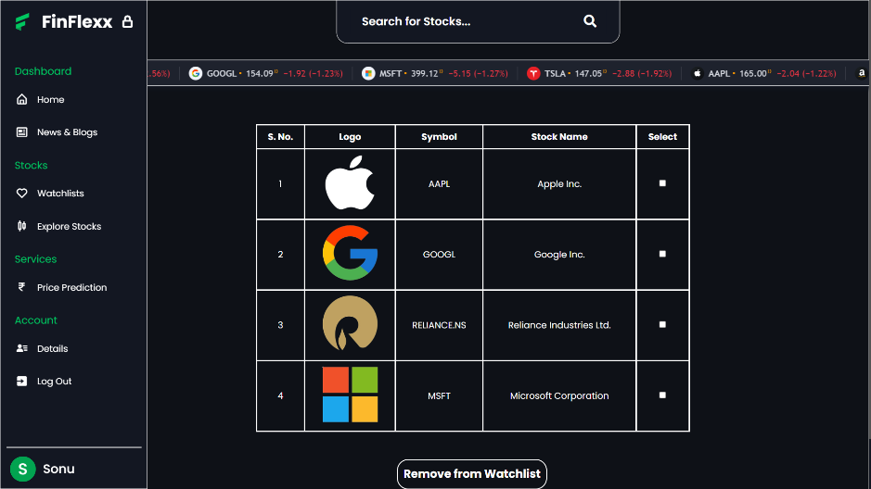
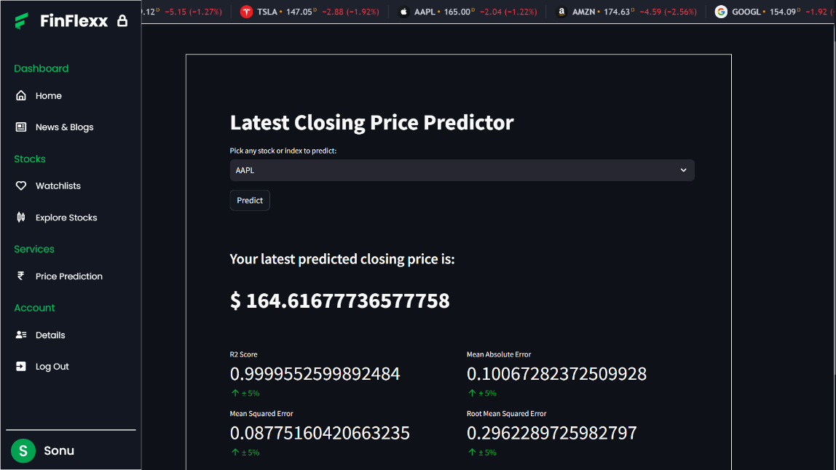
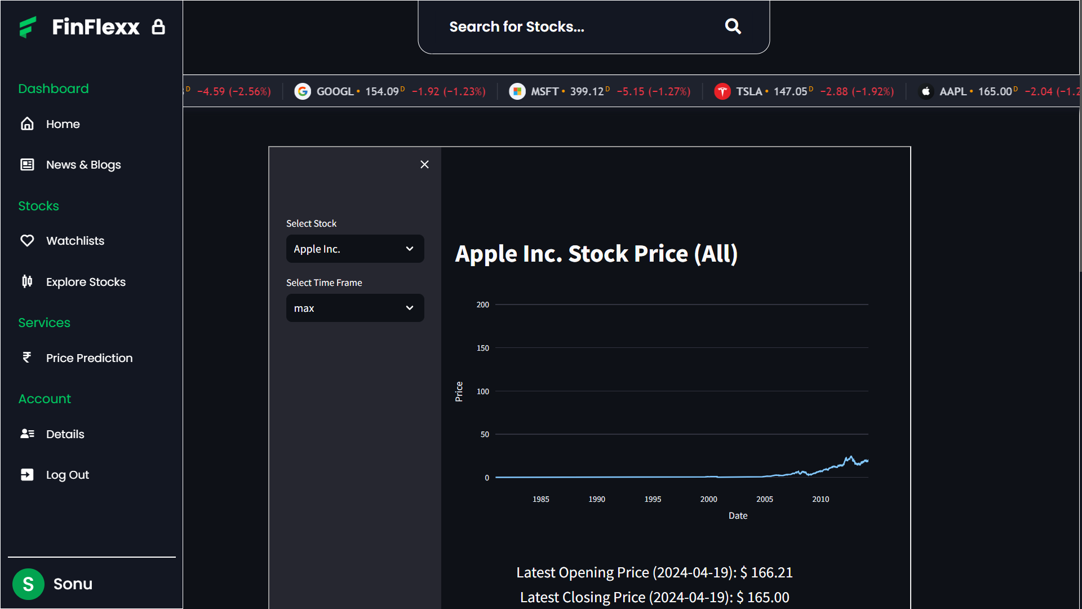
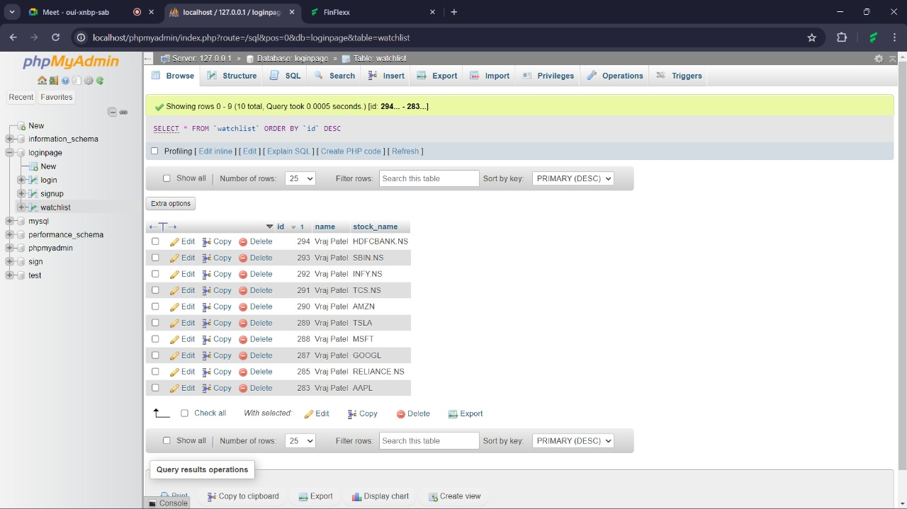



GALLERY

Slide 11

Conclusion
Thus, as we can see in the proposed method, we train the data using existing stock dataset that is available.
We use this data to predict and forecast the stock price of n-days into the future.
The current system can update its training set as each day passes so as to detect newer trends and behave like an online-learning system that predicts stock in real time.
This Photo by Unknown Author is licensed under CC BY-ND

Slide 12

Our Team
VRAJ PATEL
Website Development
KASHYAP PATEL
Data
Mining
HARSH MISTRY
Website
Designing
2101201193
AAYUSH MODI
Backend
Programming
2101201090
2101201055
2101201004

Slide 13

THANK YOU

